Slide 1
Computer
Fundamentals

Slide 2
Agenda
Operating Systems
Notes:
shortly say

Slide 3

Introduction
Were you able to finish pre-class material?
Notes:
🍐 This is a Pear Deck Multiple Choice Slide. Your current options are: A: Yes, B: No,
🍐 To edit the type of question or choices, go back to the "Ask Students a Question" in the Pear Deck sidebar.

Slide 4
Introduction
How long did it take to finish it?
Notes:
🍐 This is a Pear Deck Multiple Choice Slide. Your current options are: A: Couldn't finish, B: Up to 3 hours, C: 3-5 hours, D: More than 5 hours, E: More than 7 hours,
🍐 To edit the type of question or choices, go back to the "Ask Students a Question" in the Pear Deck sidebar.

Slide 5
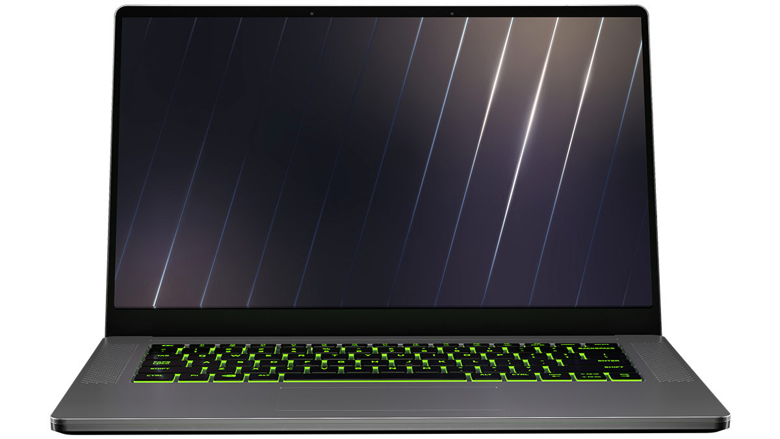
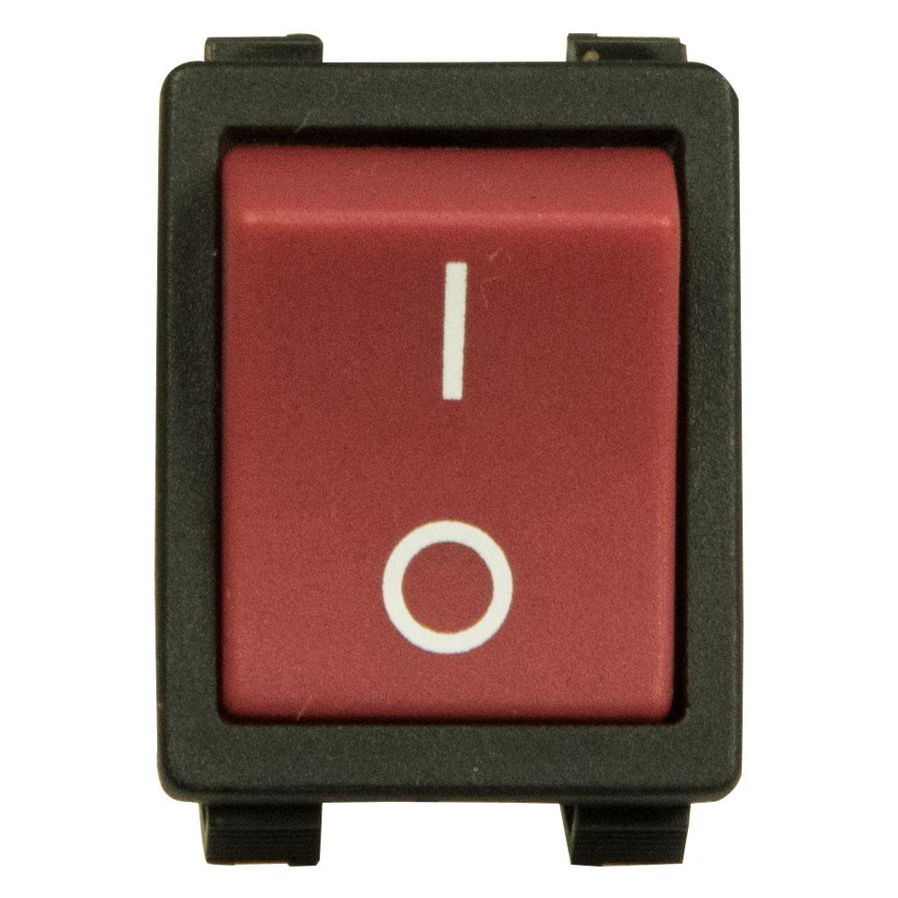
Operating Systems
Music
Video
Chat
Shopping
Coding
Reading
Gaming
Notes:
Basic Input/Output System
Software that initializes hardware and remembers system time.

Slide 6
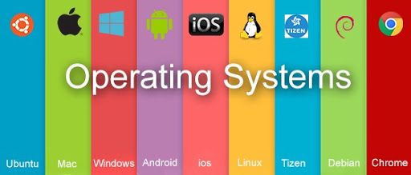
Operating Systems
OPERATING SYSTEMS:
AN OPERATING SYSTEM (OS) IS SYSTEM SOFTWARE THAT MANAGES COMPUTER HARDWARE AND SOFTWARE RESOURCES AND PROVIDES COMMON SERVICES FOR COMPUTER PROGRAMS REQUIRE AN OPERATING SYSTEM TO FUNCTION.
Notes:
Software that manages computer hardware and software.
We’re going to load OS from HDD.
Job of the OS is to let you use other computer programs.
Linux, Unix, Windows, Apple.
Even different brands, two different approaches when you power up.
Both fundamentally same. Both just allow you to interact with your computer do some stuff.
Detecting an input from the keyboard,
Sending output to the monitor or tracking files or folders in the storage area,
Controlling peripheral devices such as disk drives and printers,
Running different programs at the same time and not letting interfere with each other,
Checking users if they are authorized or not are some examples of controlling and monitoring system activities.

Slide 7
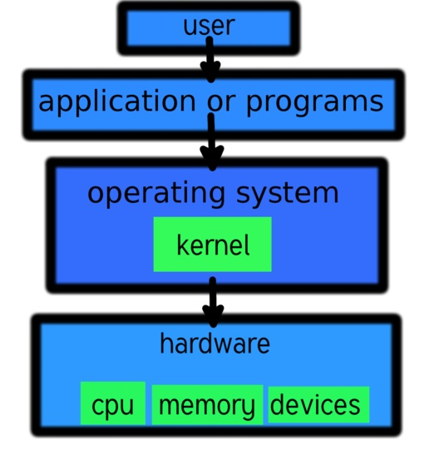
Operating Systems
Notes:
Basic Input/Output System
Software that initializes hardware and remembers system time.

Slide 8
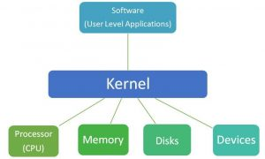
Operating Systems
Kernel:
It connects applications to the actual processing of data. It also manages all communications between software and hardware components to ensure usability and reliability.
Notes:
Basic Input/Output System
Software that initializes hardware and remembers system time.

Slide 9
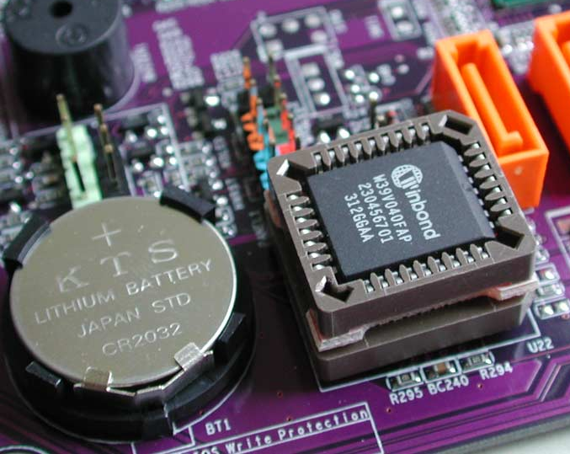
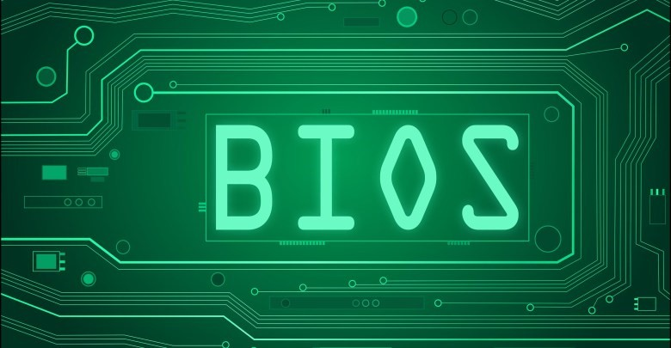
Operating Systems
BIOS (Basic Input Output System):
It is firmware used to perform hardware initialization during the booting process (power-on startup), and to provide runtime services for operating systems and programs.
Notes:
Basic Input/Output System
Software that initializes hardware and remembers system time.

Slide 10

Operating Systems
Question: What does OS manage?
Notes:
🍐 This is a Pear Deck Text Slide
🍐 To edit the type of question, go back to the "Ask Students a Question" in the Pear Deck sidebar.
Sending output to the monitor or tracking files or folders in the storage area,
Controlling peripheral devices such as disk drives and printers,
Running different programs at the same time and not letting interfere with each other,
Checking users if they are authorized or not are some examples of controlling and monitoring system activities.

Slide 11
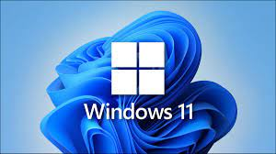
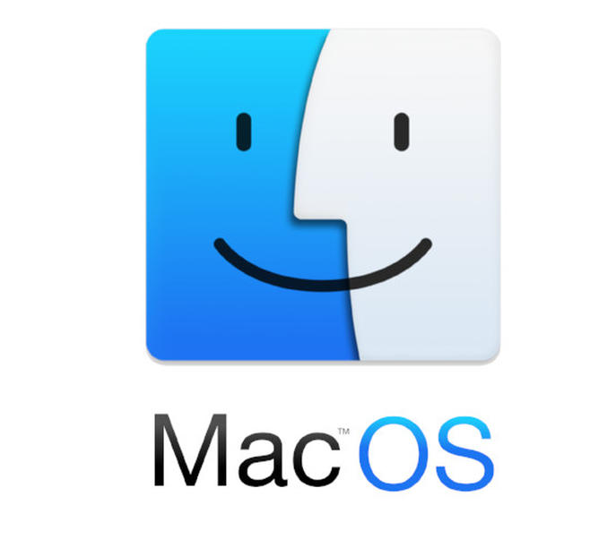



Operating Systems
Notes:
Basic Input/Output System
Software that initializes hardware and remembers system time.

Slide 12
Operating Systems
Please write your computers and mobile phones operating system.
Notes:
🍐 This is a Pear Deck Text Slide
🍐 To edit the type of question, go back to the "Ask Students a Question" in the Pear Deck sidebar.

Slide 13
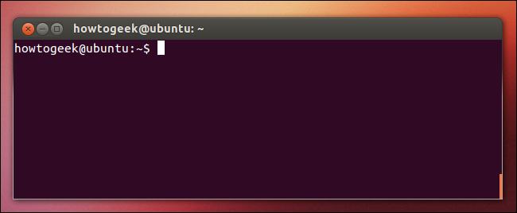
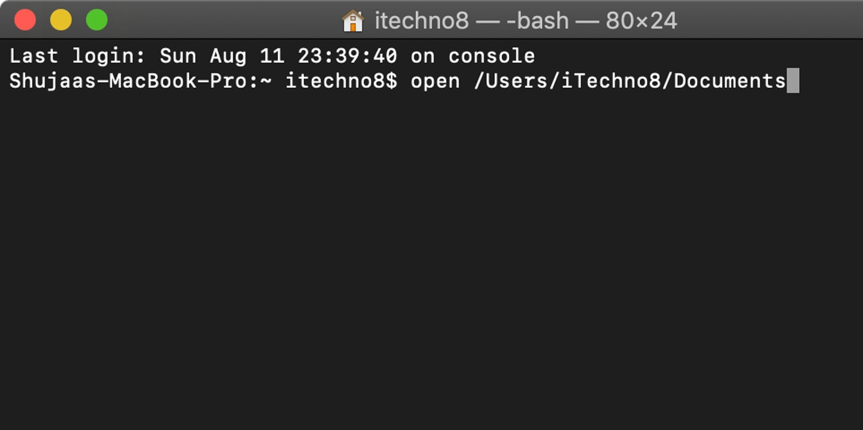
Operating Systems
Terminal
Notes:
Basic Input/Output System
Software that initializes hardware and remembers system time.

Slide 14
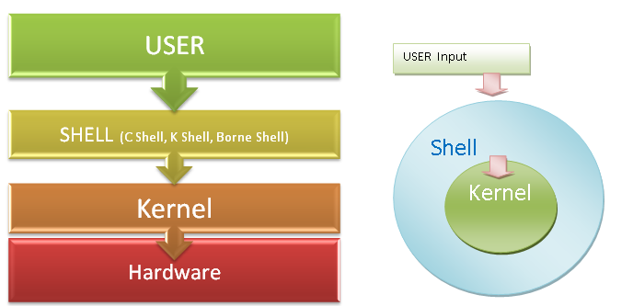
Operating Systems
Shell

Slide 15
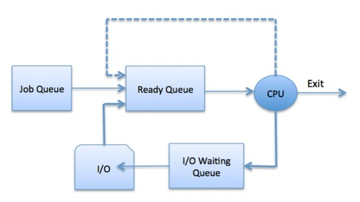
Operating Systems
What do you know about scheduling?
Notes:
🍐 This is a Pear Deck Text Slide
🍐 To edit the type of question, go back to the "Ask Students a Question" in the Pear Deck sidebar.

Slide 16
Operating Systems
Scheduling:
Multiprogramming
Multiprocessing
Multithreading
Notes:
Core program of the operating system. Handles start-up after BIOS and further input/out requests by software.

Slide 17
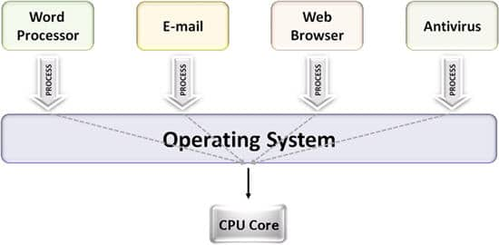
Operating Systems
Multiprogramming

Slide 18
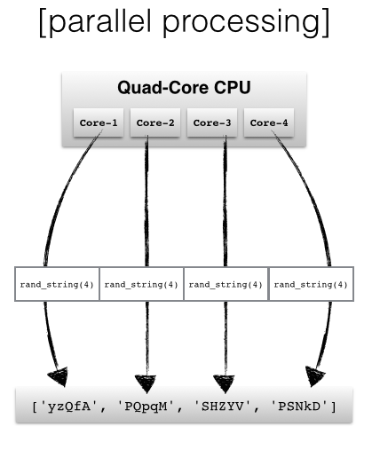
Operating Systems
Multiprocessing

Slide 19
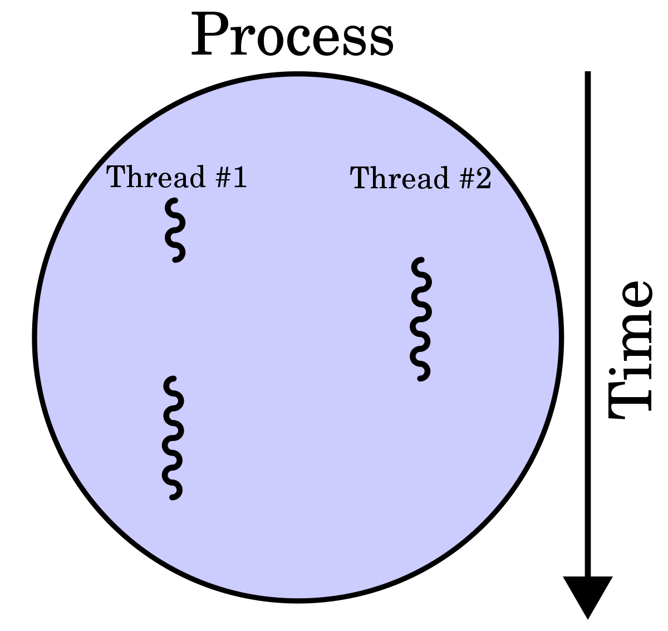
Operating Systems
Multithreading

Slide 20
Operating Systems
What is the difference between processes and threads?
Notes:
🍐 This is a Pear Deck Text Slide
🍐 To edit the type of question, go back to the "Ask Students a Question" in the Pear Deck sidebar.

Slide 21
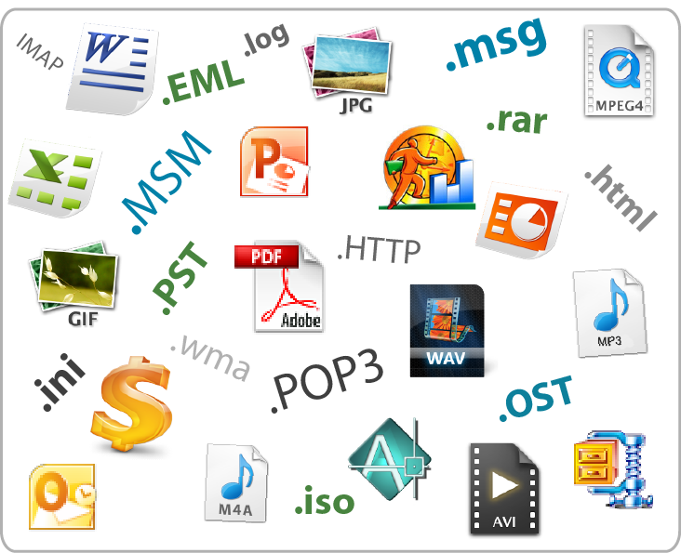
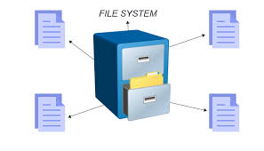
Operating Systems
Files:
Files are spaces on your computer where data is stored.

Slide 22
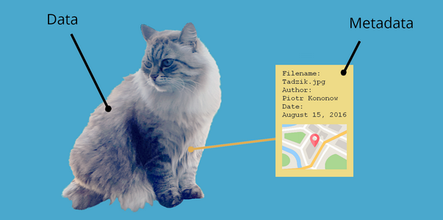
Operating Systems
Metadata

Slide 23
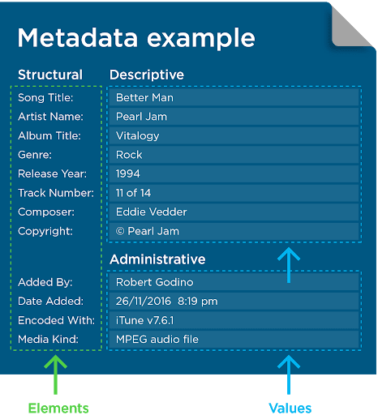
Operating Systems
Metadata

Slide 24
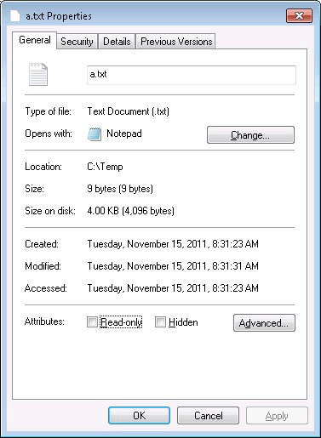
Operating Systems
File Attributes:
File attributes are metadata associated with computer files that define file system behavior.

Slide 25
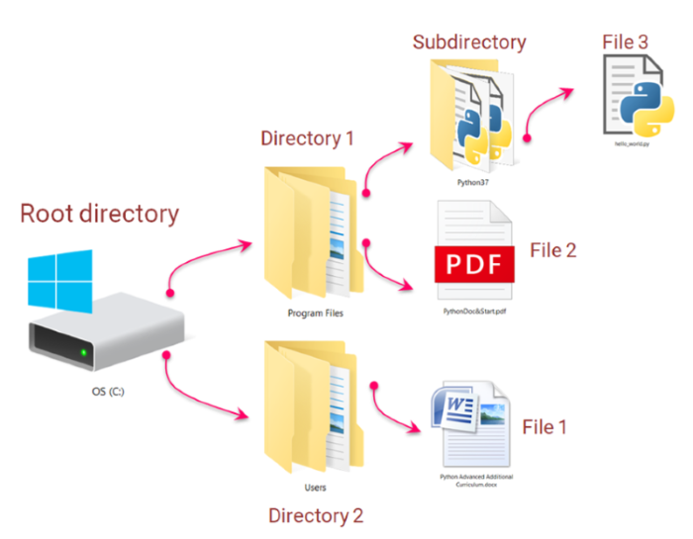
Operating Systems
Directories & Folders

Slide 26




Drag your dot to how you are feeling:
Keep going, I understand
I’m a little confused
Stop, I need help!
Notes:
Temperature Check
WIth this slide, you can get a quick idea of how your students are feeling about the pace of the lesson. Getting consensus before moving on helps ensure everyone is still with you, and identify the students who might need extra attention.
🍐 This is a Pear Deck Draggable™ Slide.
🍐 To edit the type of question, go back to the "Ask Students a Question" in the Pear Deck sidebar.

Slide 27

Notes:
Kahoot url: CF Review https://create.kahoot.it/details/a631b609-2c84-4d21-a9fe-cbe5f8ca47f1

Slide 28
THANKS!
Any questions?

